Slide 1
Mapping the solar wind HI outflow velocity in the inner heliosphere by coronagraphic VL and UV observations
Daniele Spadaro & Metis Team
INAF – Osservatorio Astrofisico di Catania
7th Solar Orbiter Workshop
Granada, Spain, 3-6 April 2017
OAC
OACt
OATs

Slide 2
Solar Orbiter:
diagnostics of the solar wind origin
One of the scientific goals of the forthcoming mission
Q1) What drives the solar wind and where
does the coronal magnetic field
originate from?
OAC
OACt
OATs

Slide 3
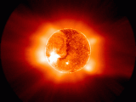
Metis: near-Sun coronagraphy
Polarized VL 580 - 640 nm
UV HI Ly α imaging @ 121.6 ± 10 nm
FoV (1.5° ⋅ 2.9° annular, 1.6 – 3.0 R◉ @ 0.28 AU)
Spatial sampling element ≤ 4000 km (20”) @ 0.28 AU
Time resolution ≥ 1 sec
Simultaneous VL and UV imaging
Notes:
2 times better than LASCO C2

Slide 4
Metis data will provide an unprecedented
view of the solar wind acceleration region
in the inner corona:
Investigate the capability of mapping the
solar wind outflow velocity for HI atoms
using synergy between VL and UV
OAC
OACt
OATs

Slide 5
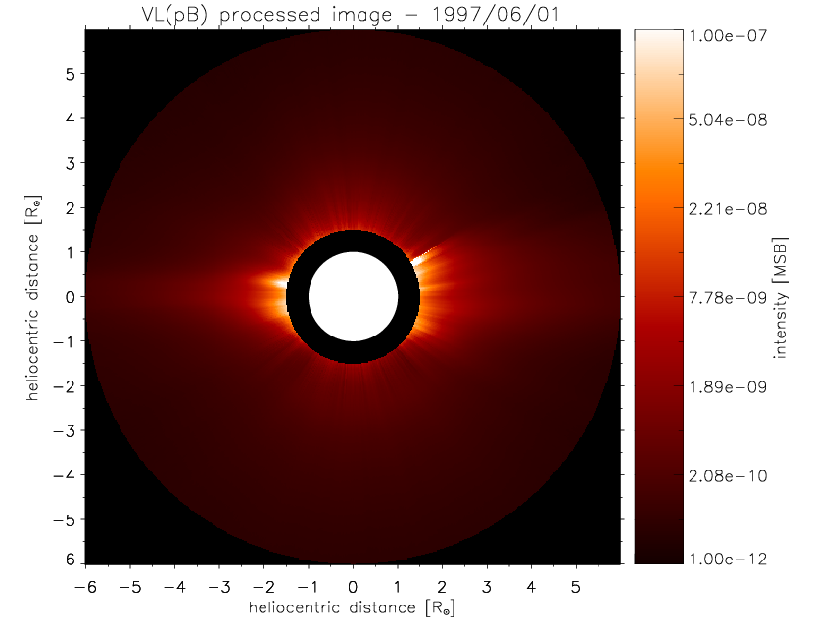
VL (pB) coronal images
Mauna Loa Mk3
&
SOHO/LASCO-C2
pB images on 1997,
1st – 28th June,
built linking up the data from the two coronagraphs
Simulation of Metis pB
OAC
OACt
OATs

Slide 6
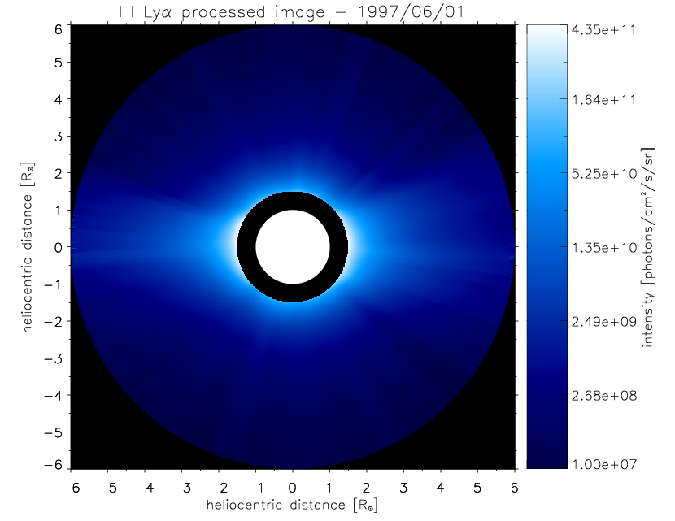
UV (HI Lyα) coronal images
SOHO/ UVCS
Lyα images on 1997,
1st – 28th June,
built by a double power law radial fitting
of daily synoptic spectral intensity data
Simulation of Metis Lyα
OAC
OACt
OATs

Slide 7
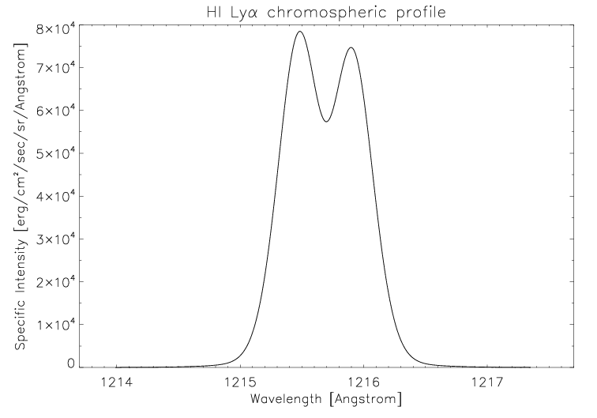
Outflow velocity estimate
Doppler dimming technique (Noci, 1973; Withbroe et al., 1982) → comparison between measured and simulated HI Lyα intensity
→ Matching of observations
Measured coronal electron density radial profiles from standard Van De Hulst inversion of pB images (see, e.g., Hayes et al. 2001, Dolei et al. 2015)
Doppler
dimming
input
parameters
T_{e} radial profile from Gibson et al. (1999)
T_{HI} coronal map from Dolei et al. (2016) – see the following slide
Uniform HI Lyman-alpha chromospheric
profile representative of the emission
during the minimum phase of the solar
activity cycle
(Lemaire et al., 2002; Auchère, 2005)
OAC
OACt
OATs

Slide 8
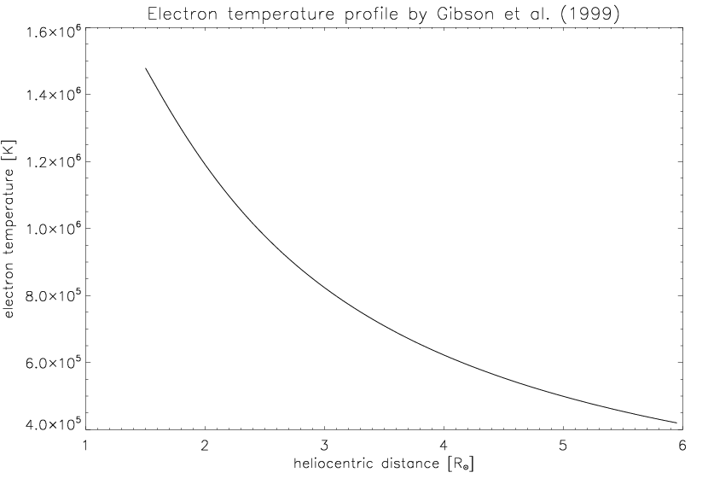
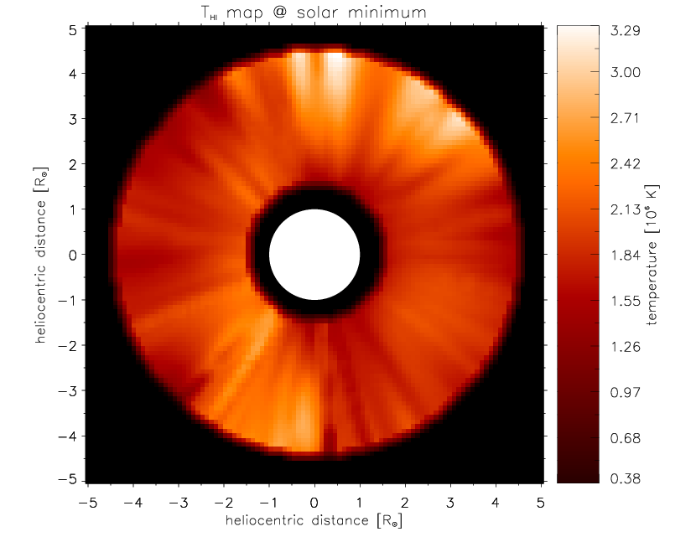
Outflow velocity estimate
T_{e} radial profile
T_{HI} map from UVCS Lyα line profiles
OAC
OACt
OATs

Slide 9
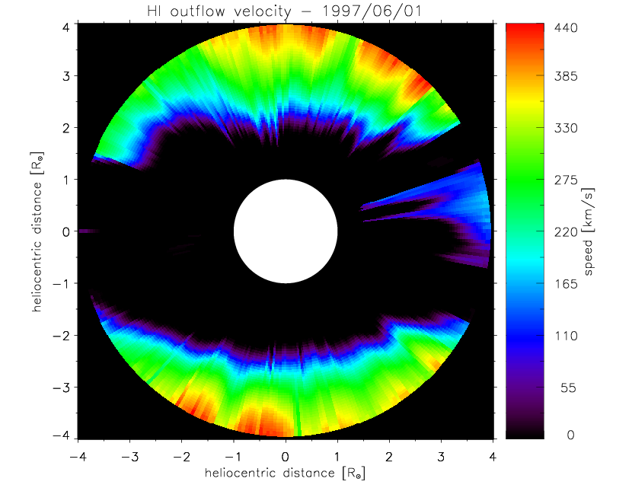
Daily outflow velocity maps
1.5 – 4.0 R
Distribution of
solar wind
speeds on the
plane of the
sky (POS)
Source surface radius
Time interval:
28 days
1997 June,
1st – 28th
OAC
OACt
OATs

Slide 10
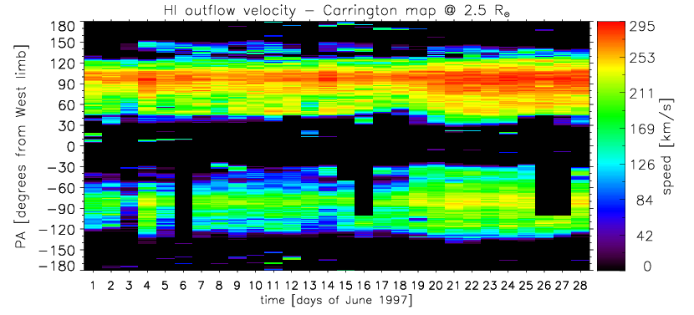
Construct a Carrington-like map
Covering in part CR-1923 & CR-1924
Solar wind outflows @ 2.5 R (source surface radius)
North-South asymmetry between the polar regions

Slide 11
North-South asymmetry between the polar regions:
also evidenced by Ulysses’ solar wind measurements (e.g., McComas et al. 2000)
by interplanetary scintillation (IPS) tomography analysis (e.g., Kojima et al. 2001, Tokumaru et al. 2015,2016)
by SOHO/SWAN Lyα remote sensing (e.g., Bzowski et al. 2003)
- Comparison of these results with current models
for the heliospheric propagation of solar wind is
important and useful in view of an efficient
exploitation of the science data of Solar Orbiter.
OAC
OACt
OATs

