Slide 1
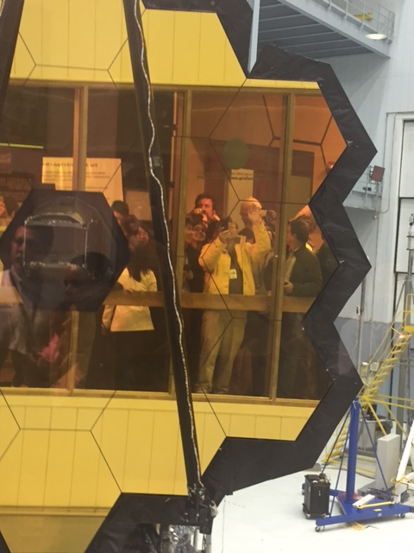
Energetic Radiation Impacts on Space Weathering: Mercury – Mars
John F. Cooper, Heliospheric Physics Laboratory, NASA Goddard Space Flight Center
Solar and heliospheric energetic particle data resources of the NASA Space Physics Data Facility (SPDF) and Virtual Energetic Particle Observatory (VEPO)
Data question: what are are the time-averaged flux spectra of protons and He in the inner heliosphere from Mercury to Mars from the ensemble of data sources?
How do these flux spectra compare to the 1997 – 2005 (8.25 yr) fluence spectra compiled by Mewaldt et al. (SSR, 2007)?
Can the Mewaldt spectra be used as reasonable time-averaged representation for space weathering of planetary surfaces?
TBD for future work: how does the total solar energetic particle energy flux vary on yearly to solar cycle time scales?
TBD: what is the radial gradient of this time-averaged energy flux between the orbits of Mercury, Earth, Mars and beyond?
TBD: Huge expansion in data from SO, SPP!
$8B Selfie! JWST and Me
March 31, 2017

Slide 2
Abstract. Exposed surfaces of all airless planetary bodies in the inner solar system, from dust grains to planets and moons, are variably bombarded and modified by solar energetic particle and photon radiation. The structural and chemical states of these surfaces evolve over thousands to billions of years in response to solar and other irradiation. Some processes of high interest include interactions with near-solar dust to form the inner source of suprathermal ions, radiolytic modification of molecular chemistry in the polar ices of Mercury and the Moon, surface and exospheric water production by surface interaction, and surface implantation of solar wind volatiles. For human exploration destinations (the Moon, asteroids, and the moons of Mars), as well as for in-space journeys to those destinations, more energetic radiation from the Sun and other sources will contribute as hazards to human explorers, settlers, and supporting robotic systems.
This presentation reports on the cumulative flux spectra of protons and helium at plasma to cosmic ray energies in the inner solar system as derived from mission data resources of the NASA Space Physics Data Facility and the Virtual Energetic Particle Observatory operated by NASA Goddard Space Flight Center. Solar Orbiter and Solar Probe Plus will substantially add to these resources. Do the cumulative spectra over multiple solar cycles evolve toward relatively constant forms, independent of heliocentric position inward from the orbit of Mars, such that these reference spectra can be applied to modeling of long-term space weathering effects? As averaged over all available mission data, is the inner heliosphere best modeled as a charged particle reservoir with relatively small variations in time-average intensity between the orbits of Mercury and Mars? How do the total energy fluxes vary on yearly to solar cycle time scales, and as function of solar distance?

Slide 3
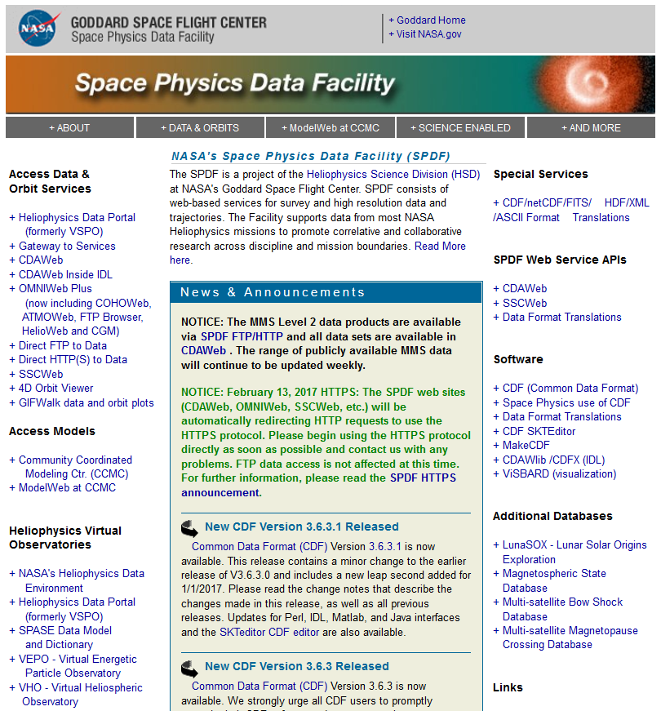
Project Scientist: Robert E. McGuire NASA GSFC
spdf.gsfc.nasa.gov
NASA Active Final Archive for non-imaging solar, geospace, and heliospheric data
Heliophysics Data Portal (VxO)
Value-Added Data Services
CDAWeb OMNIWeb HelioWeb
SSCWeb
Common Data Format (CDF) standards and tools

Slide 4
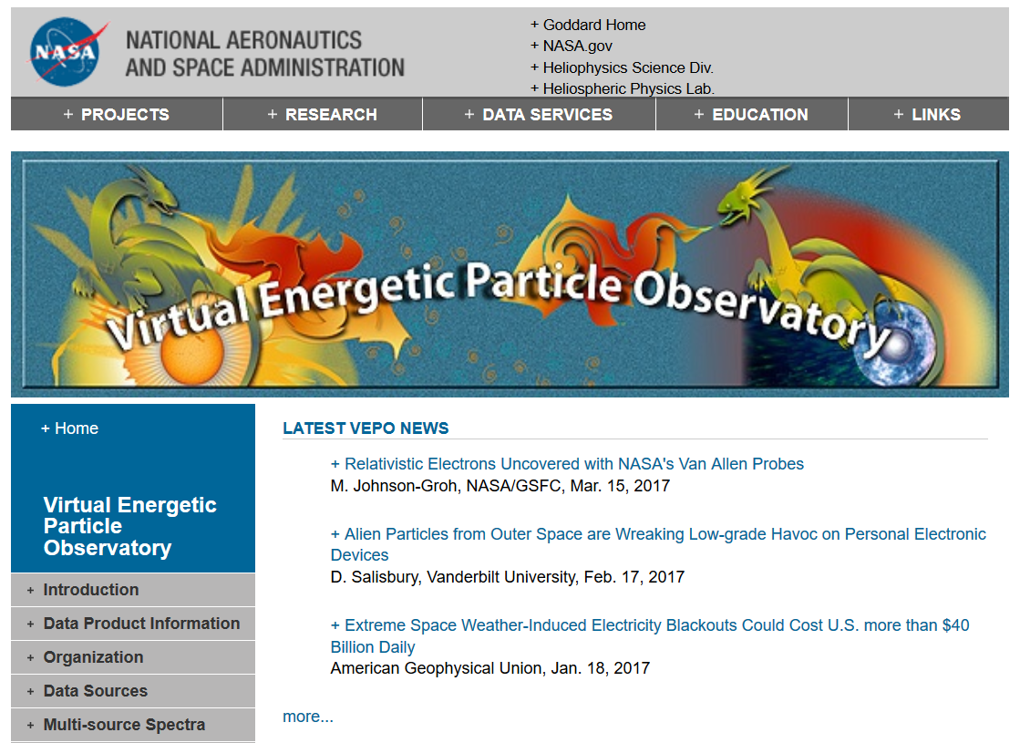
vepo.gsfc.nasa.gov
Principal Investigator: John F. Cooper, NASA GSFC
Warning: Be careful what data you look for, you may find it !

Slide 5
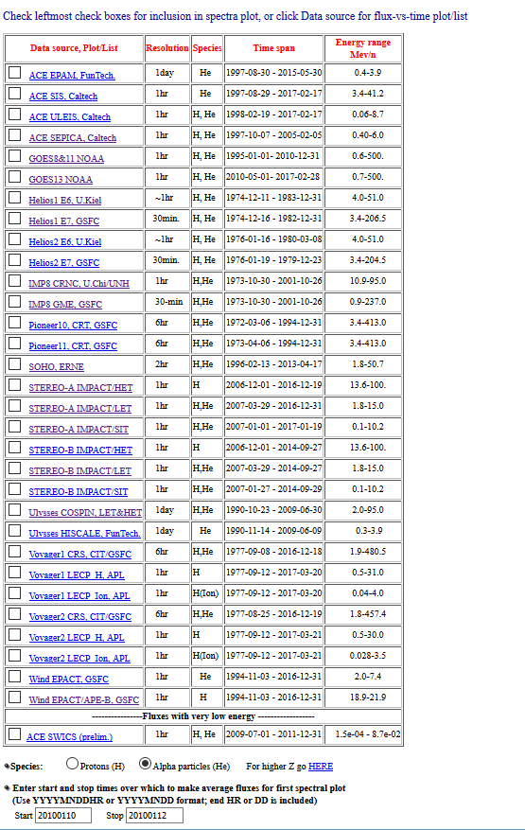
https://omniweb.gsfc.nasa.gov/ftpbrowser/flux_spectr_m1.html
VEPO Multi-Source Spectral Plots (MSSP-1) for differential flux spectra of protons and alphas in the heliosphere. H – Ni heavy ion flux spectra also available from selected sources.
Other plot types including time history, ratio, and scatterplots. H – Ni heavy ion data
Sources
ACE EPAM, SIS, ULEIS, SEPICA
ACE SWICS 2008 – 2011 (+ more TBD)
GOES 8, 11, 13
Helios 1-2 E6, E7
IMP-8 CRNC, GME
Pioneer 10-11 CRT (+ CPI TBD)
SOHO ERNE
STEREO A-B HET, LET, SIT
Ulysses COSPIN, HISCALE
Voyager 1-2 LECP, CRS
WIND EPACT LEMT, APE-B
New Horizons: SWAP, PEPSII data will come later via Planetary Data System

Slide 6
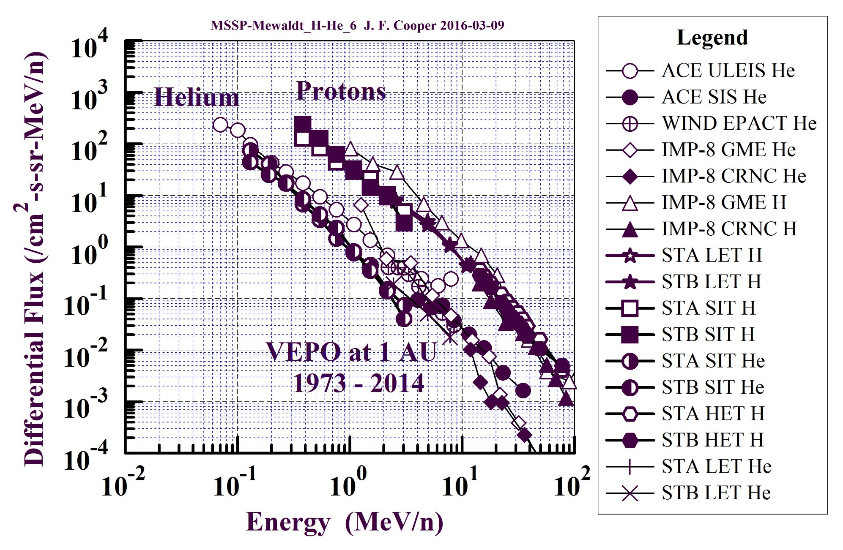
Composite Proton and Helium Spectra at 1 AU from VEPO MSSP-1 Data

Slide 7
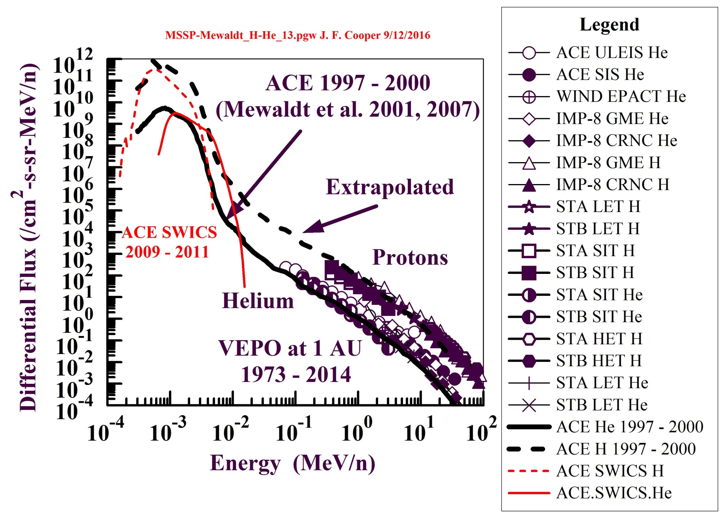
Full flux distributions for protons and alphas are nearly now available from conjunction of ACE SWICS, ULEIS, EPAM, and SIS sensor data with additional fluxes from other sources including WIND EPACT, SOHO ERNE, STEREO A,B (HET, LET, SIT). This potentially enables coupling of thermal and suprathermal particle flux spectra for investigation of space weathering processes involving charged particle interactions with planetary surfaces.

Slide 8
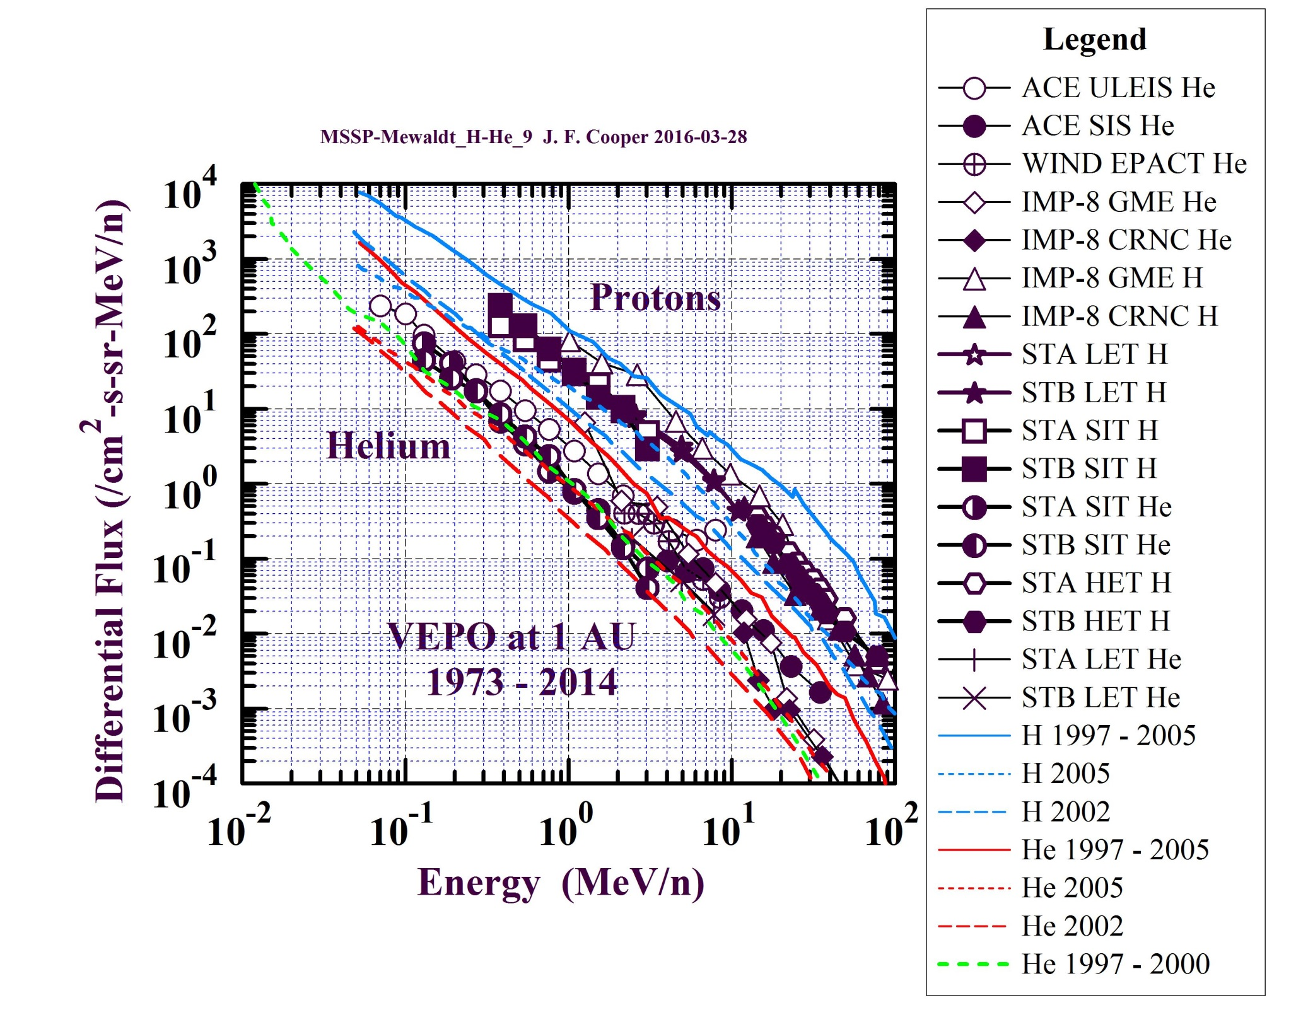
VEPO flux data comparison to time-averaged flux spectra for He in 1997 – 2000 from Mewaldt et al (2001) and for H and He during 2002, 2005, and 1997 – 2005 from Mewaldt et al. (2007)
Mewaldt 1997 – 2005 fluxes are generally higher due to efficiency corrections for large solar energetic particle events.

Slide 9
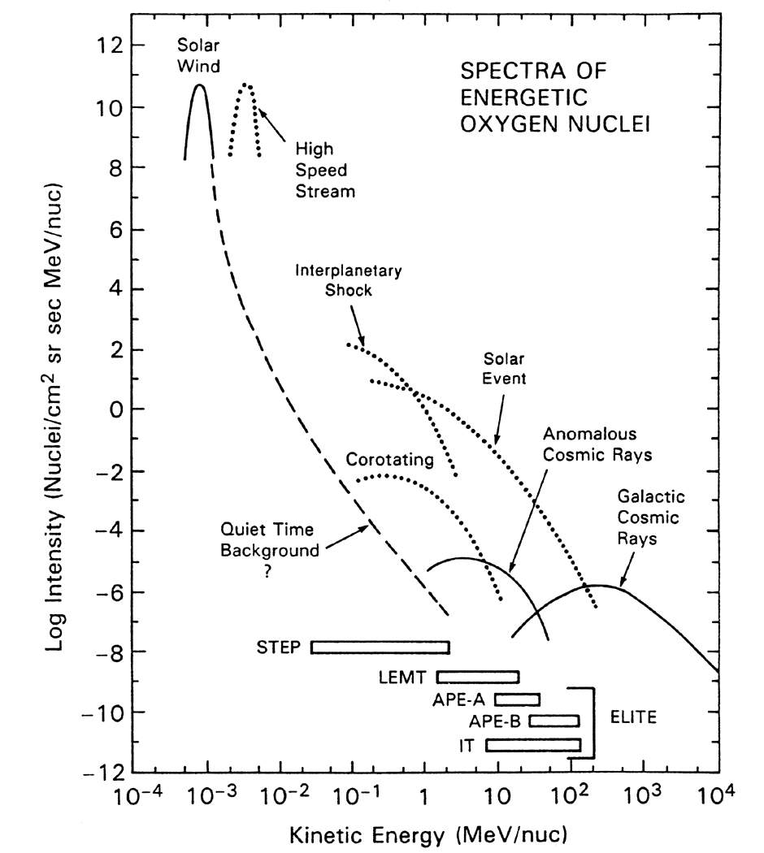
The time-averaged flux spectra of energetic particles at 1 AU (L1 halo orbit for WIND spacecraft) comes from various sources as measured here by the WIND EPACT (Energetic Particles: Acceleration, Composition and Transport) instrument.
Large solar events and associated interplanetary shocks are the primary sources at 0.1 – 100 MeV/n.
Such events tend to fill the inner solar system to Mars and beyond with energetic particles, so the time-averaged fluxes from multiple events do not have much radial variation from 1 AU to Mars.
Is this also true inward towards orbit of Mercury as seen by Helios 1-2 ?
http://universe.gsfc.nasa.gov/archive/epact/epact.html

Slide 10
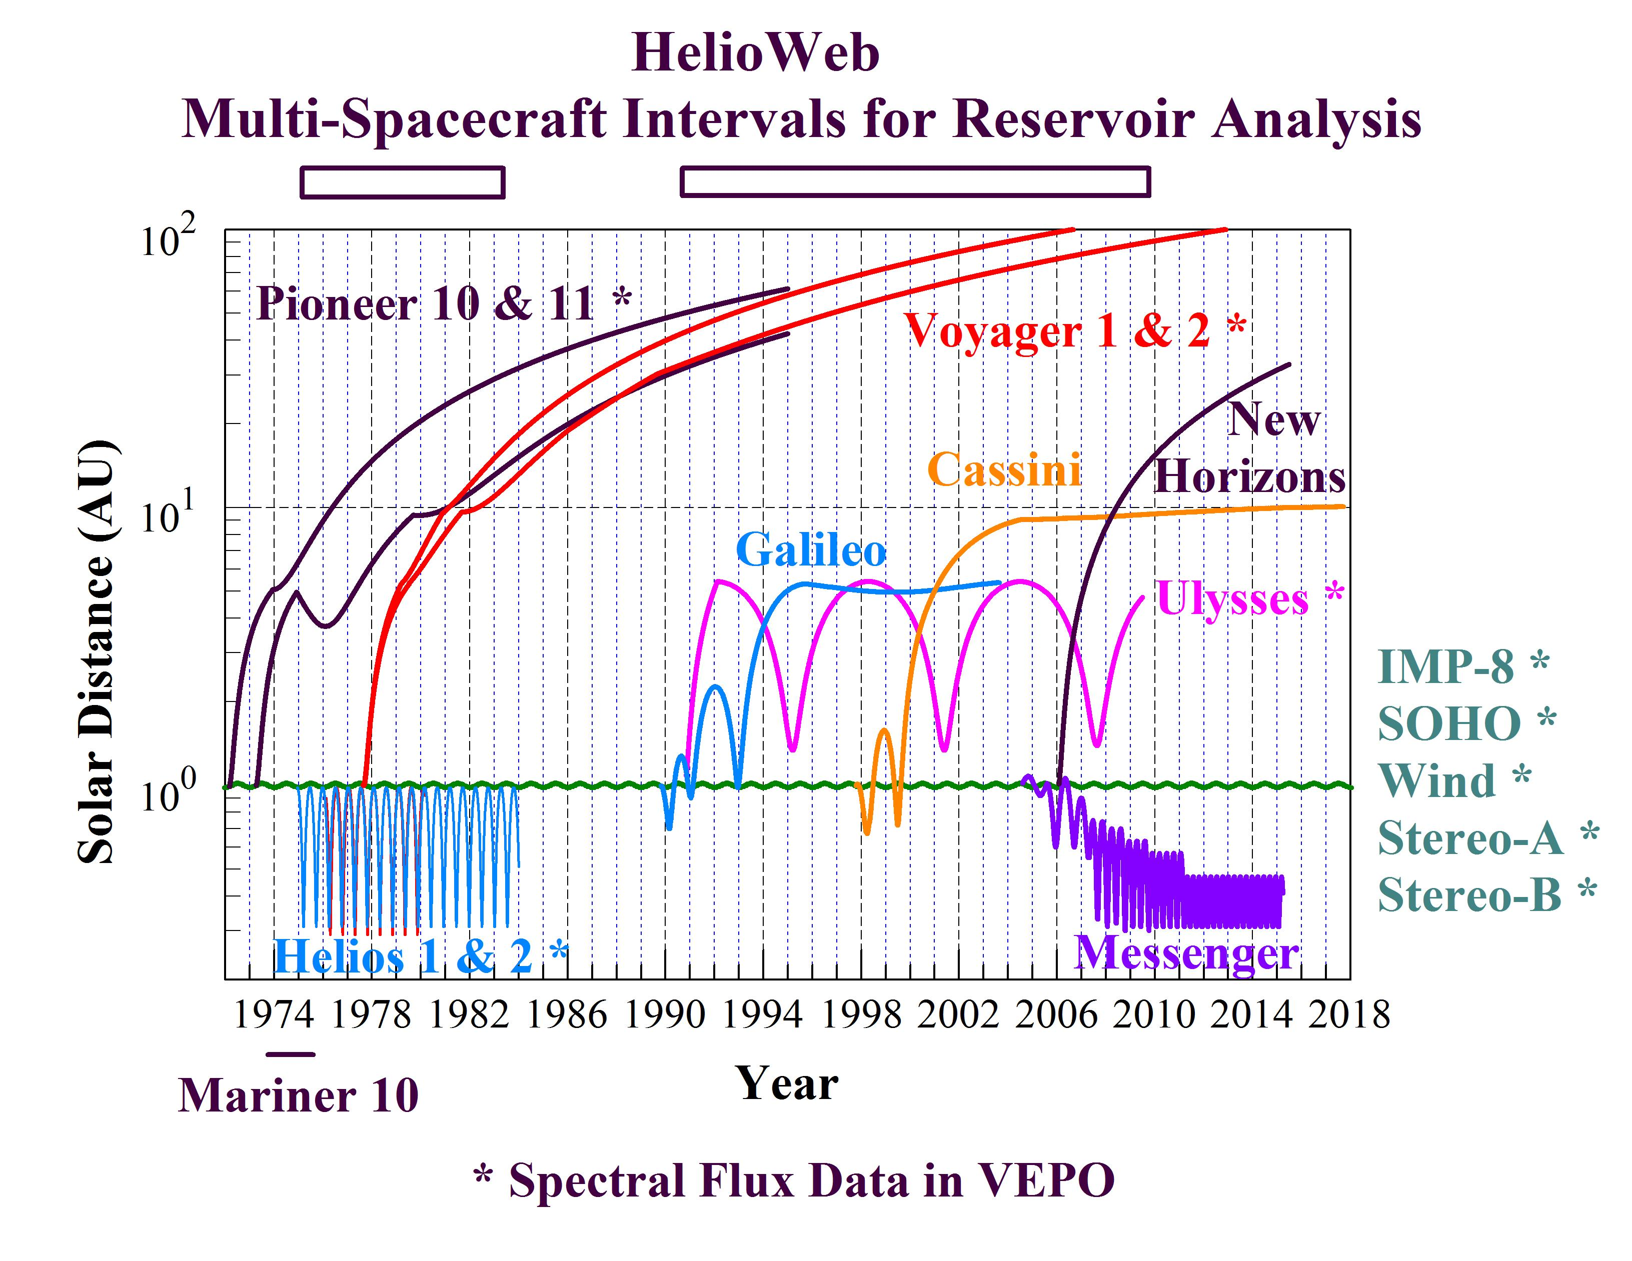
The multi-source spectral plots and tabular data allow investigation of large scale radial and longitudinal gradients in intensities from multiple spacecraft and instrument sources, e.g. between the orbits of Mercury, Venus, Earth, Mars, and beyond …

Slide 11
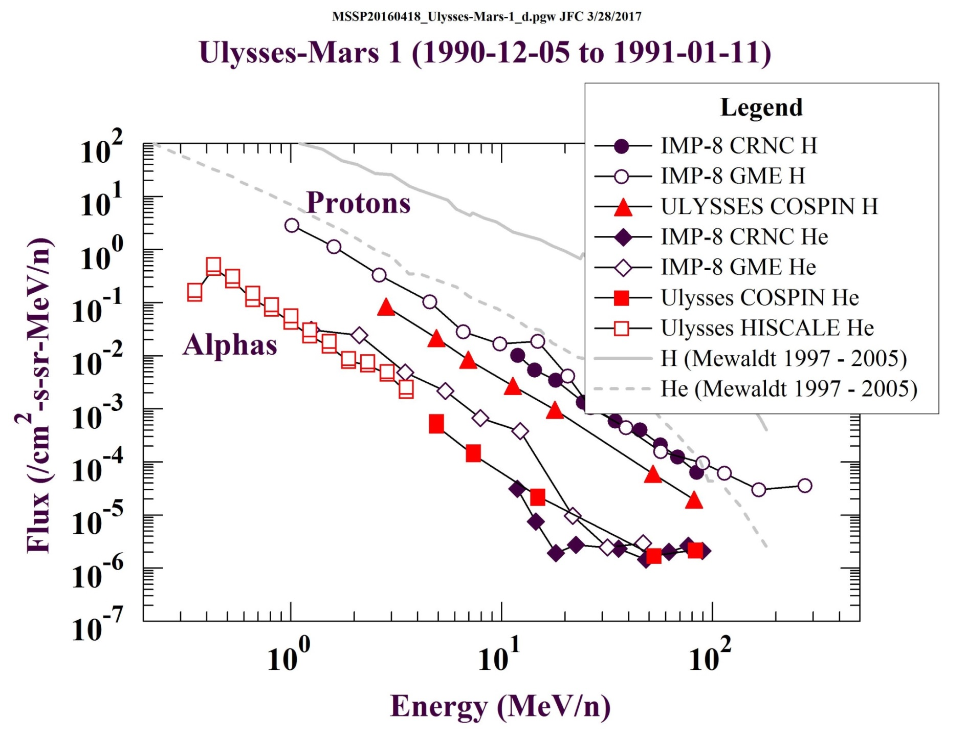
Comparison of Ulysses HISCALE and COSPIN flux spectra for protons and alphas during two periods (1990, 2007) when Ulysses was near the 1.405 – 1.639 AU solar distance of Mars

Slide 12
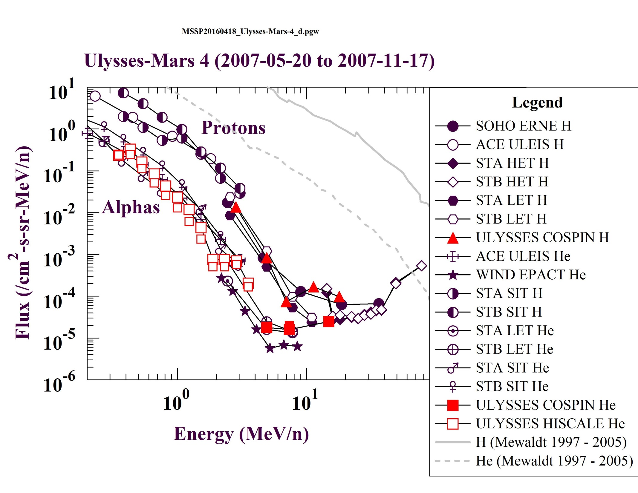

Slide 13
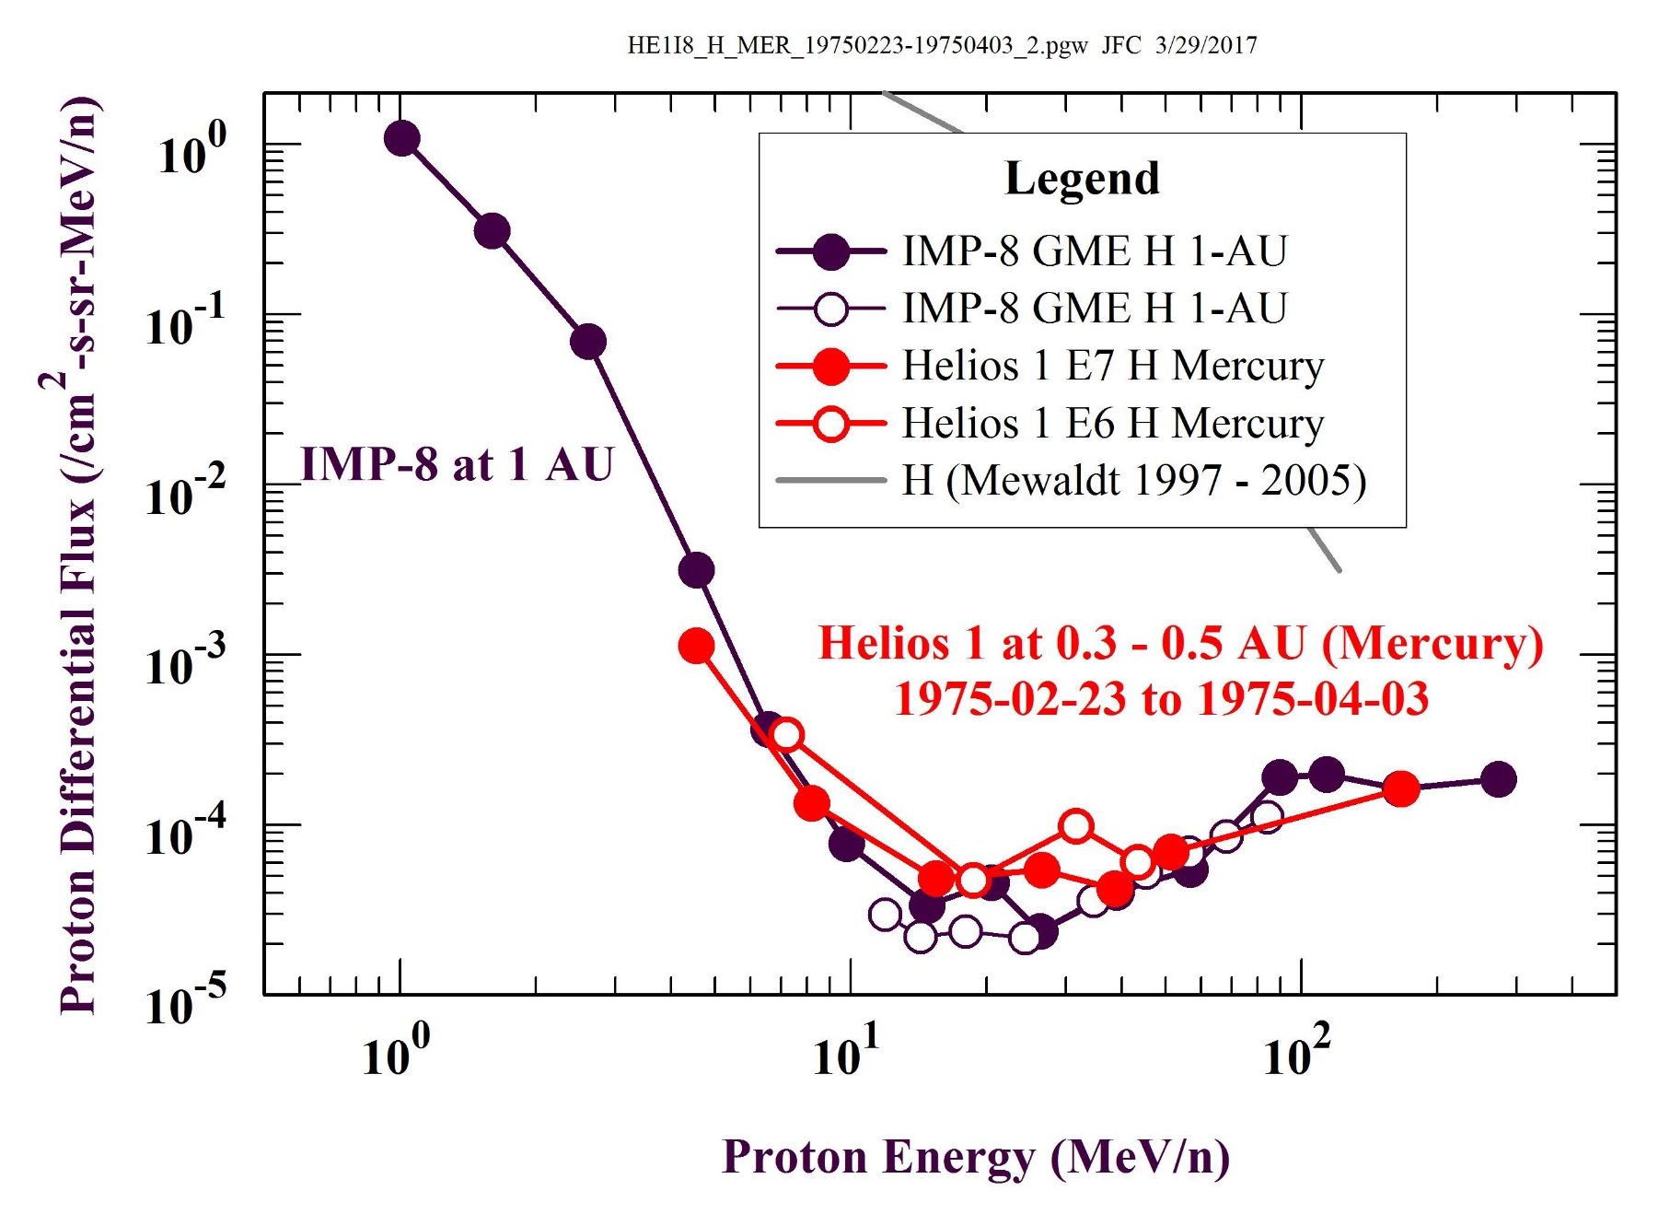
Helios-1 – 1 AU comparison for low (1975) and high (1979) solar activity

Slide 14
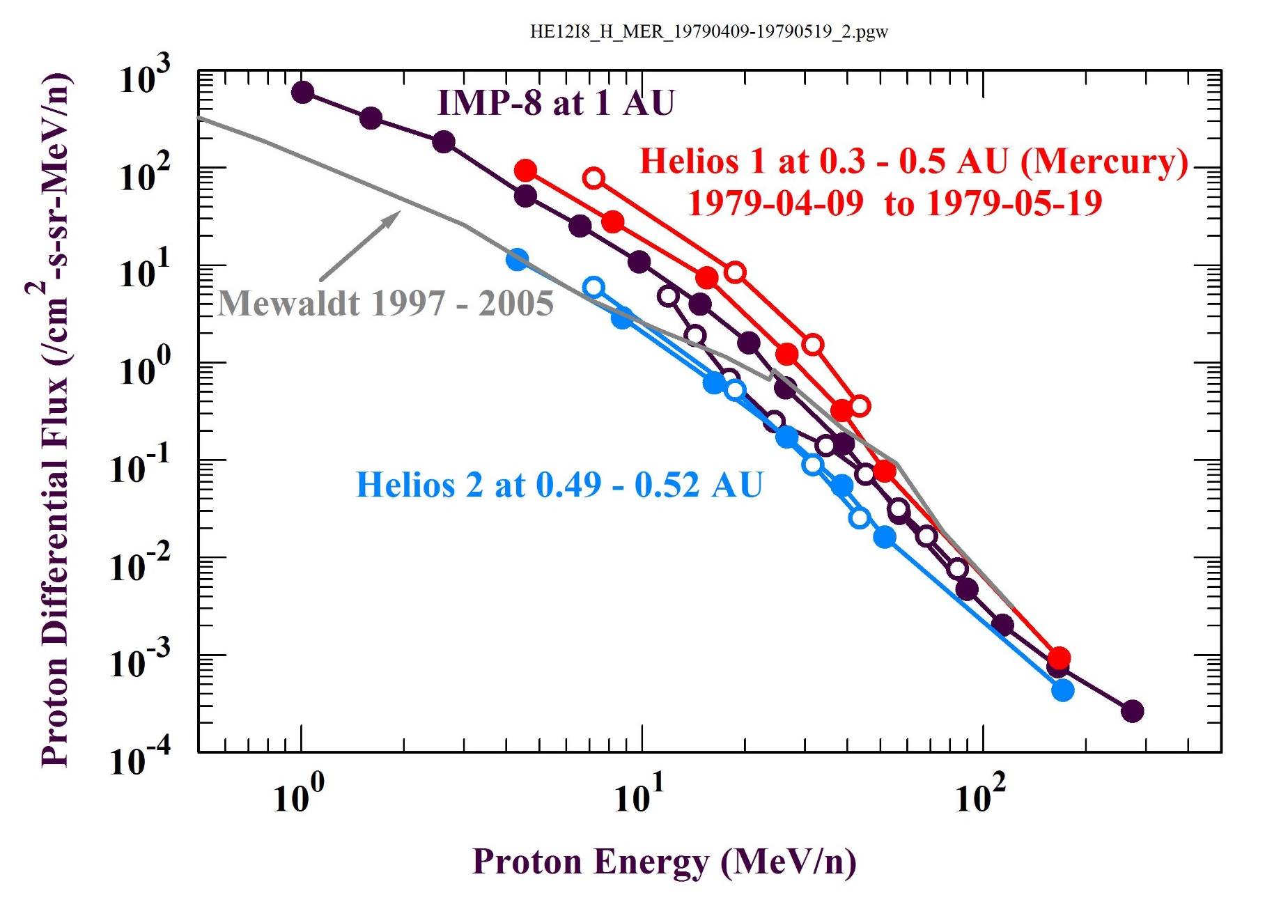

Slide 15
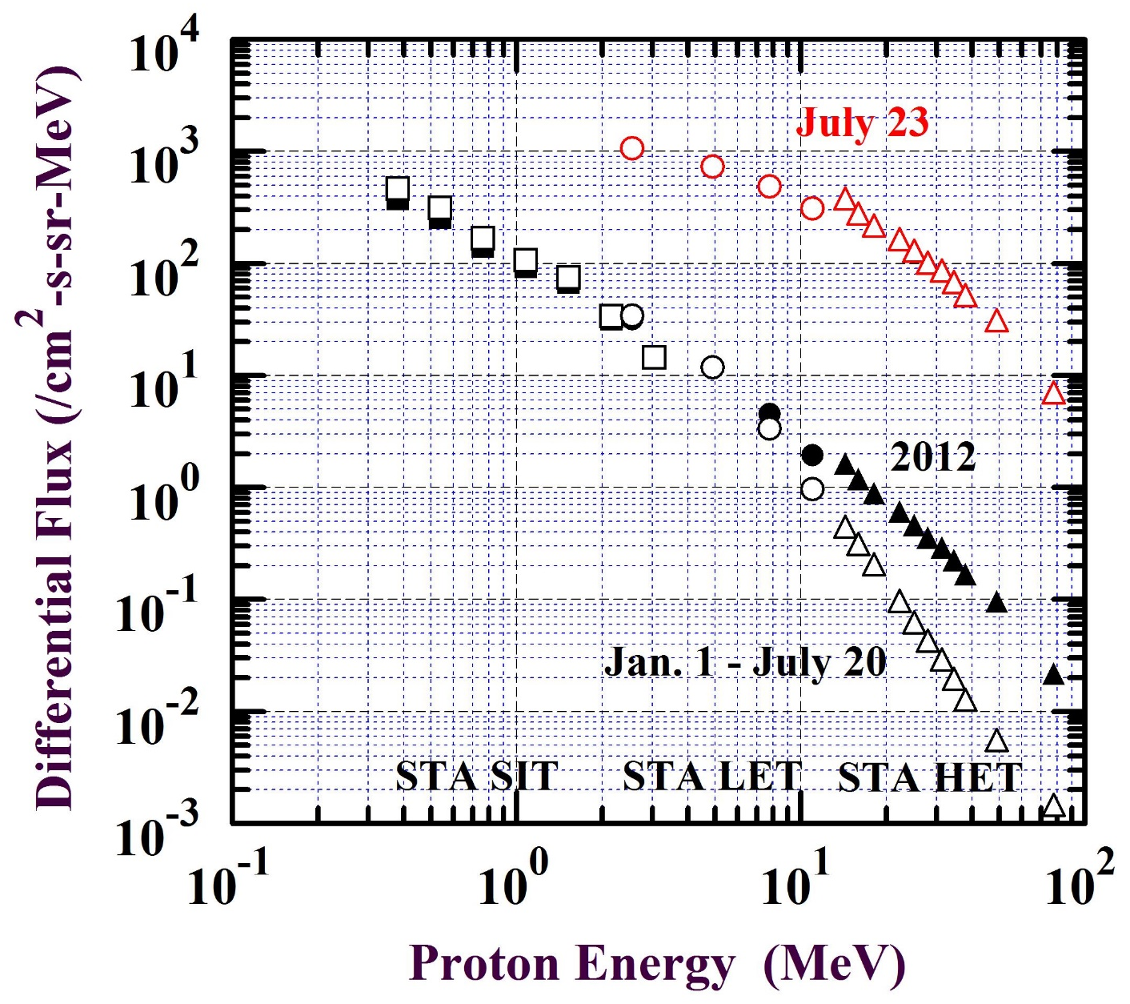
How much are long-term averages biased by large SEP events? E.g. 2012 “Carrington Event”.
Space weathering by more penetrating particles can be greatly affected by single large events during a year, e.g. 2012
The “Carrington Event” of July 23rd provides most of the >10 MeV proton flux at 1 AU during that year.
There were many other SEP events during 2012 (see time history plot below) but these mostly had softer flux spectra as per those shown through Jan. 20th.

Slide 16
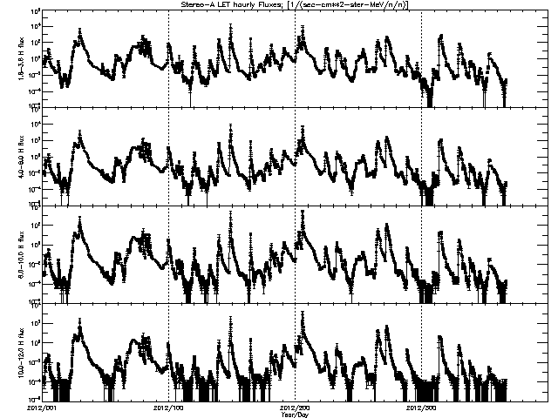
Stereo A LET Proton Fluxes for 2012
Jan. 23
1.8 – 3.6 MeV
4.0 – 6.0 MeV
6.0 – 10.0 MeV
10.0 – 12.0 MeV

Slide 17
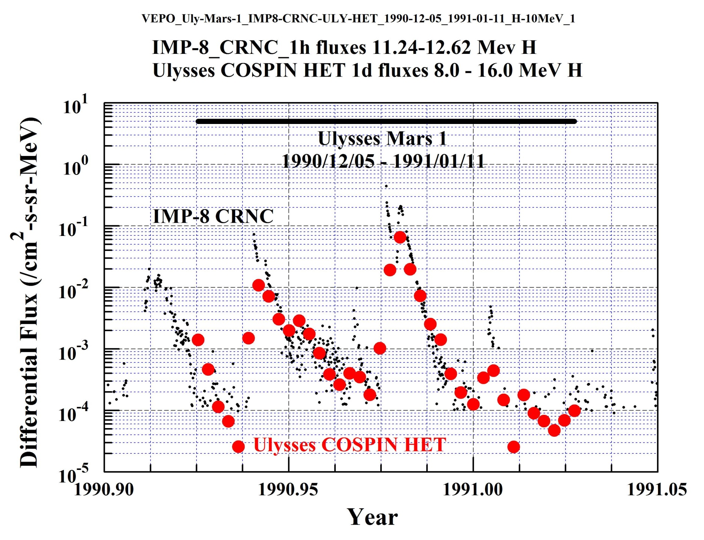

Slide 18
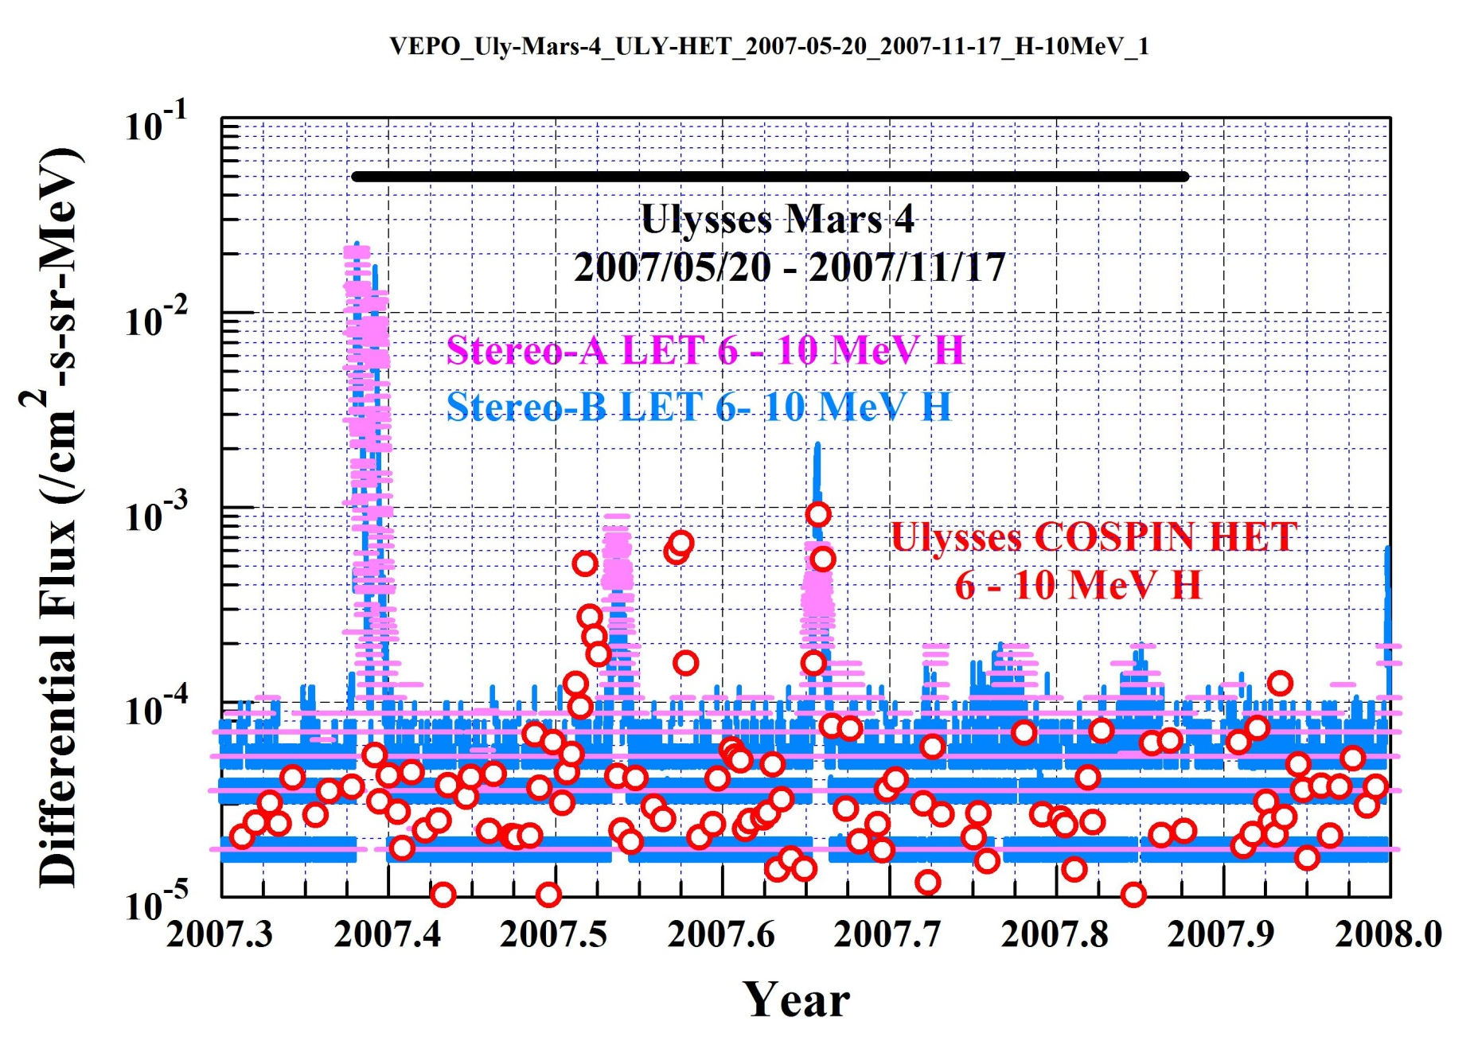

Slide 19
Space Weathering Application
Radiolytic Chemistry of Ices
Time in years at 1 AU to fully process exposed surface ices at 100 eV per 16 amu as function of depth in cm H₂O.
E.g., 1 H₂O₂ produced per 1000 eV in H₂O.
Affects polar ices at the Moon and Mercury as irradiated by energetic protons
Measurable radiation ageing of ices vs depth ?
4.5 Gyr
1 Gyr
Inferred From Mewaldt 2001 He spectrum, similar for 1997 – 2005 H spectrum (Mewaldt 2007)
10 Myr
10³ yr
Equivalent shielding by Earth’s atmosphere
(1 bar = 1000 g/cm²)
1 keV
proton
1 MeV
proton
10 MeV
proton
100 MeV
proton

Slide 21
References
Mewaldt, R. A., G. M. Mason, G. Gloeckler, E. R. Christian, C. M. S. Cohen, A. C. Cummings, A. J. Davis, J. R. Dwyer, R. E.Gold, S. M. Krimigis, R. A. Leske, J. E. Mazur, E. C. Stone, T. T. von Rosenvinge, M. E. Widenbeck, and T. H. Zurbuchen, Long term fluences of energetic particles in the heliosphere, in Solar and Galactic Composition, AIP Conf. Proc. 598, pp. 165-170, R. F. Wimmer-Schweingruber (ed.), AIP, Melville, NY, 2001.
Mewaldt, R. A., C. M. S. Cohen, G. M. Mason, D. K. Haggerty, and M. I. Desai, Long-Term Fluences of Solar Energetic Particles from H to Fe, Sp. Sci. Rev., 130, 323–328, doi:10.1007/s11214-007-9200-8, 2007.

